Slide 1
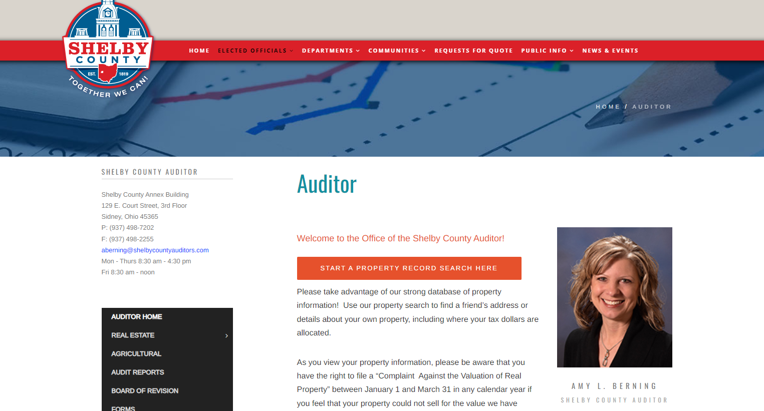
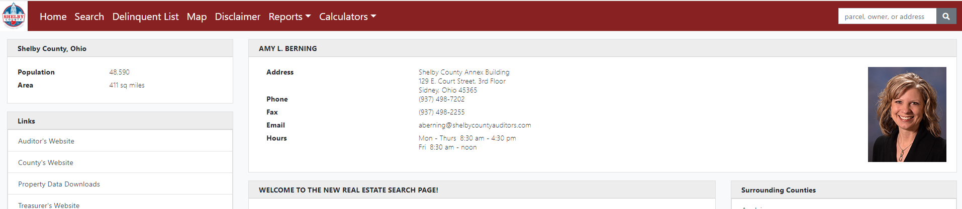
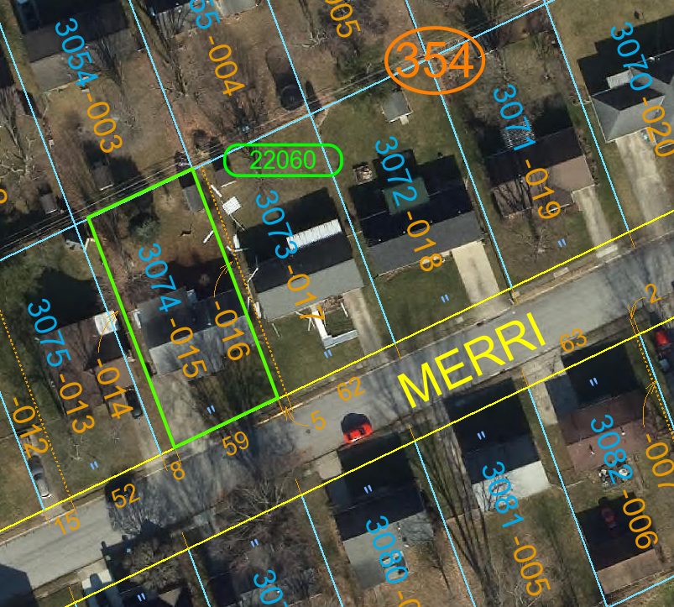
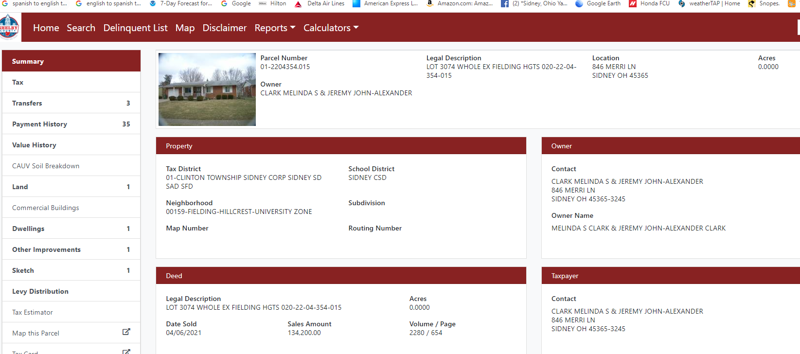
﻿﻿​Auditor – Welcome To Shelby County Ohio
Type in name or address
2.
Click Here
Print out a large map of your property. 24” by 36” is ideal
1.
5.
3.
Legal Description
4.
View Map

